Slide 1
CS 547
Week 3 Day 2
MySQL & Pattern Matching

Slide 2
Agenda
Prepared Statements
PHP Session
Cookies
Pattern Matching

Slide 3
Announcement
No Class on Feb 19, 2015

Slide 4
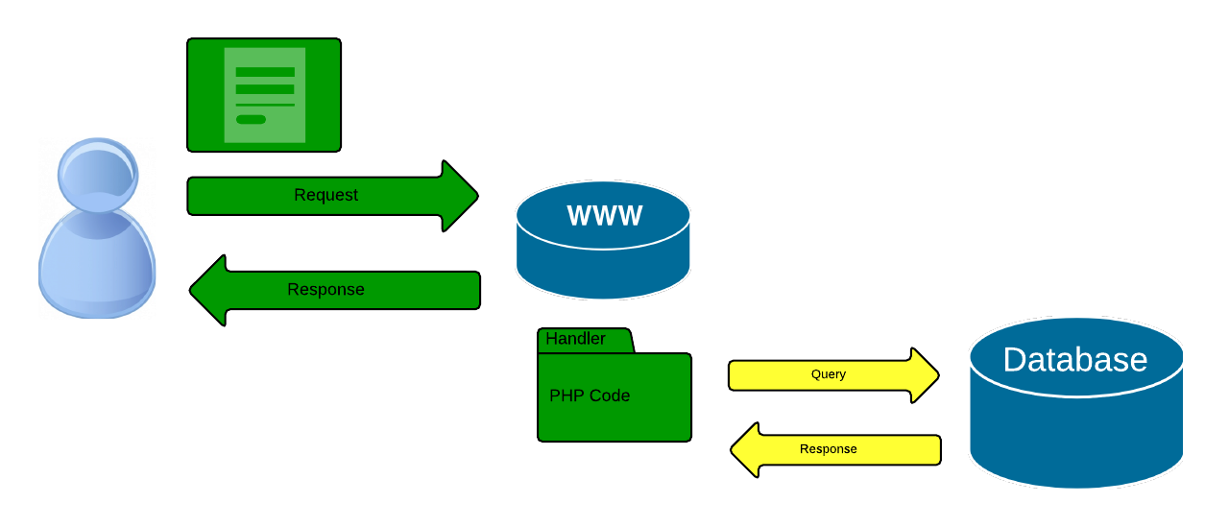
Review

Slide 5
MySQLi Basics
mysqli_conn();
mysqli_select();
mysqli_insert();
mysqli_update();
mysqli_delete();

Slide 6
MySQLi Prepared Statements
Why?
Used to mitigate against SQL injections.
Benefits
Reduce time and minimize bandwidth
Prepared statements are very useful against SQL injections, because parameter values, which are transmitted later using a different protocol, need not be correctly escaped. If the original statement template is not derived from external input, SQL injection cannot occur.
Notes:
From http://www.w3schools.com/php/php_mysql_prepared_statements.asp

Slide 7

Prepared Statements: Little Bobby Tables
Notes:
http://xkcd.com/327/

Slide 8
SQL Injection: The problem
//
if ($conn->connect_error) {
trigger_error('Database connection failed: ' . $conn->connect_error, E_USER_ERROR);
}
else {
$sql='SELECT * FROM mytable WHERE (pkid = "' . $_POST["name"] . '") ; ';
$rs=$conn->query($sql);
if($rs === false) {
trigger_error('Wrong SQL: ' . $sql . ' Error: ' . $conn->error, E_USER_ERROR);
} else {
$rows_returned = $rs->num_rows;
echo ("Found " . $rows_returned . " rows.<hr>");
$rs->data_seek(0);
while($row = $rs->fetch_assoc()){
echo ("Name = " . $row['name'] . " age = " . $row['realAge'] . "<br>" )
}
Notes:
With this code…

Slide 9
SQL Injection: The problem
With malformed strings like
2' or 1; select * from mytable ;
We get results we didn’t expect
Notes:
with this type of string

Slide 10
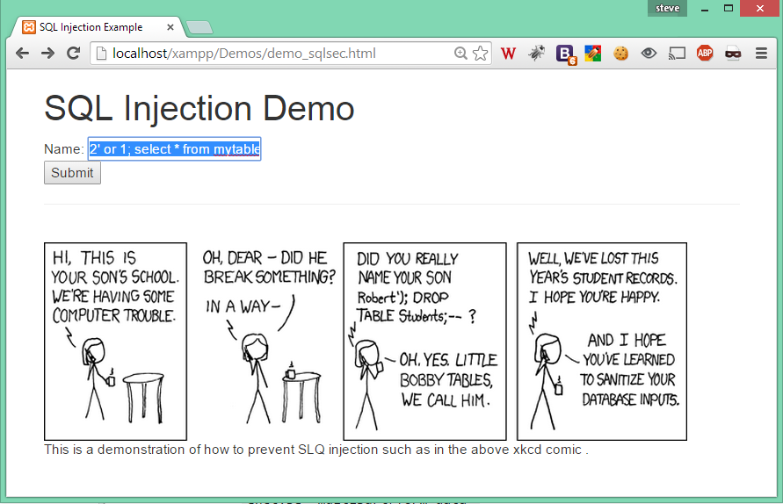
Demo
Notes:
All records returned;

Slide 11
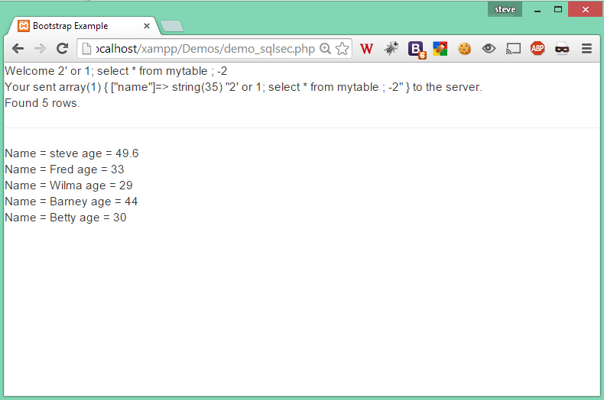
Demo
Not what you want.
Notes:
All records returned;

Slide 12
SQL Injection Mitigation
The solution to SQL injection types of attacks is complicated and requires vigilance and understanding on the part of the programmer.
One can not blindly rely on a one size fits all solution.
You must understand what your code is doing and design your code appropriately.
Notes:
In other words you must think when you code.

Slide 13
SQL Injection Mitigation
Techniques:
Prepared Statements
Sanitizing Input
Notes:
In other words you must think when you code.

Slide 14
Prepared Statements and Bound Parameters
Lifecycle
Prepare: An SQL statement template is created and sent to the database. Certain values are left unspecified, called parameters (labeled "?"). Example: INSERT INTO mytable VALUES(?, ?, ?)
Parse: The database parses, compiles, and performs query optimization on the SQL statement template, and stores the result without executing it
Execute: At a later time, the application binds the values to the parameters, and the database executes the statement. The application may execute the statement as many times as it wants with different values

Slide 15
SQL Injection Solution
if ($stmt = $conn->prepare("SELECT pkID, name, age, realAge, phone, email FROM mytable WHERE name=?")) {
$stmt->bind_param("s", $_POST["name"]);// Bind a variable to the parameter as a string.
$stmt->execute(); // Execute the statement.
$stmt->bind_result($pkID, $name, $age, $realAge, $phone, $email);
$stmt->store_result(); /* Store the result (to get properties) */
$num_of_rows = $stmt->num_rows;
/* Bind the result to variables */
$stmt->bind_result($pkID, $name, $age, $realAge, $phone, $email);
$stmt->fetch(); // Fetch the data.
// Display the data.
printf(“ID %s is %s. They are %s, but really they are %s”, $name, $pkID, $age, $realAge);
}

Slide 16
Caution about User Input
Never trust user Input.
All user input shoud be sanitized.
Use mysqli_real_escape_string();
or PDO::quote();
Notes:
Goto the php manual and review these functions… http://php.net/manual/en/function.mysql-real-escape-string.php
http://php.net/manual/en/function.mysql-real-escape-string.php

Slide 17
Sanitizing User input
mysqli_real_escape_string -- Escapes special characters in a string for use in an SQL statement, taking into account the current charset of the connection
Parameters
link
Procedural style only: A link identifier returned by mysqli_connect() or mysqli_init()
escapestr
The string to be escaped.Characters encoded are NUL (ASCII 0), \n, \r, \, ', ", and Control-Z.
Returns: the escaped string;
Notes:
You can avoid all character escaping issues (on the PHP side) if you use prepare() and bind_param(), as an alternative to placing arbitrary string values in SQL statements. This works because bound parameter values are NOT passed via the SQL statement syntax.

Slide 18
What if you want to validate input?
To validate user input you must match the input to a pattern. PHP uses Regular Expressions (called RegEx) to do this. A regex is a a sequence of characters that forms a search pattern, mainly for use in pattern matching with strings, or string matching, i.e. "find and replace"-like operations
Notes:
This is a big topic, Please review the Wikipedia http://en.wikipedia.org/wiki/Regular_expression and
the php.net http://php.net/manual/en/function.preg-match.php

Slide 19
PHP Regular Expressions
preg_match() — Perform a regular expression match
int preg_match ( string $pattern , string $);
int preg_match ( string $pattern , string $subject [, array &$matches [, int $flags = 0 [, int $offset = 0 ]]] );

Slide 20
Regular Expressions
Validate Name
$name = test_input($_POST["name"]); if (preg_match("/^[a-zA-Z ]*$/",$name)) {
echo (“Found a name”);

Slide 21
RegEx Patterns
if (preg_match(“ /^[a-zA-Z ]*$/", $name))
the yellow text is the important part.

Slide 22
RegEx Patterns
Operator list (the pattern to match) is contained in the / /
Simple characters match
/a/ -> a
/b/ -> b
/cd/ -> cd

Slide 23
RegEx
Square brackets denote a class of characters
/[ab]/ -> a , ab , b, and ba but not A

Slide 24
RegEx
A dash (-) inside square brackets denote a range of characters
/[a-z]/ -> all lower case characters but not A-Z

Slide 25
Reg Ex
The ^, $ * and . have special meanings
^ = Line start
$ =Line end
* = 0 or more time
. = any character except a new line

Slide 26
Reg Ex: Character Classes
Character classes
. | any character except newline
\w \d \s | word, digit, whitespace
\W \D \S | not word, digit, whitespace
[abc] | any of a, b, or c
[^abc] | not a, b, or c
[a-g] | character between a & g

Slide 27
Reg Ex Boundaries
^abc$ | start / end of the string
\b | word boundary

Slide 28
RegEx: Escaped Characters
\. \* \\ | escaped special characters
\t \n \r | tab, linefeed, carriage return
\u00A9 | unicode escaped ©

Slide 29
RegEx: Quantifiers
a* a+ a? | 0 or more, 1 or more, 0 or 1
a{5} a{2,} | exactly five, two or more
a{1,3} | between one & three
a+? a{2,}? | match as few as possible
ab|cd | match ab or cd

Slide 30
Regular Expressions
Take some time to learn by example.
visit the site http://www.regexr.com/
Notes:
http://www.regexr.com/

Slide 31
Regular Expressions
Rich amount of regular expression functions in the php library. Check out the PCRE pages on php.net. Of interest may be
preg_match(); and preg_match_all()
preg_filter(); and preg_replace();
and
preg_split();
Notes:
http://php.net/manual/en/book.pcre.php

Slide 33
PHP Sessions
Sessions are used to preserve data across page visits. Sessions can either be stored with the URL or in a cookie on the client.
Sessions are created with the session_start (); function and are accessible through the super global $_SESSION variable;

Slide 34
Session Code Demo

Slide 35
PHP Cookie
Cookies store information on the client.
Notes:
http://php.net/manual/en/function.setcookie.php

Slide 36
PHP Cookie Demo

